Slide 1
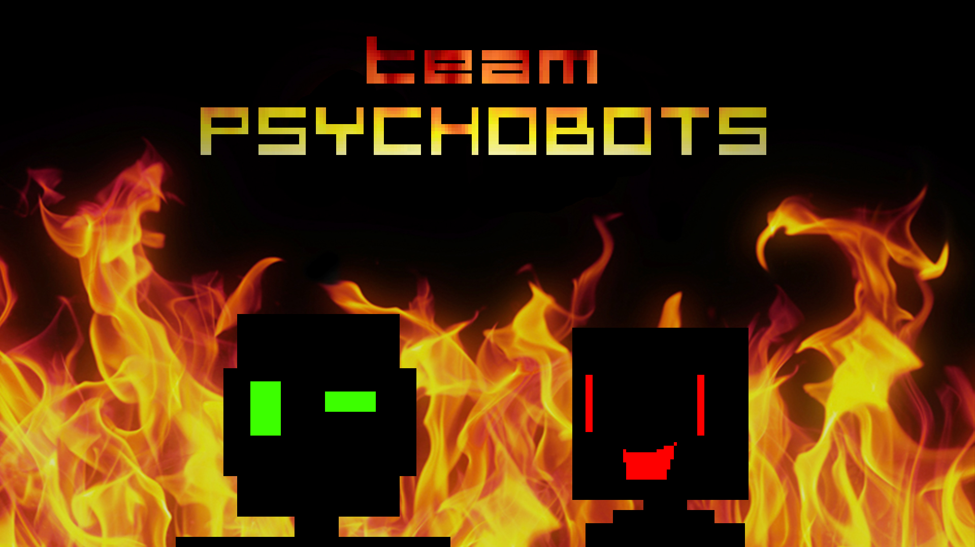

Slide 2



Slide 3
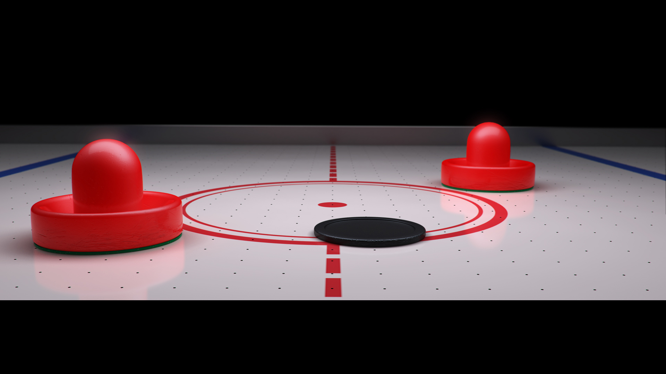

Slide 4
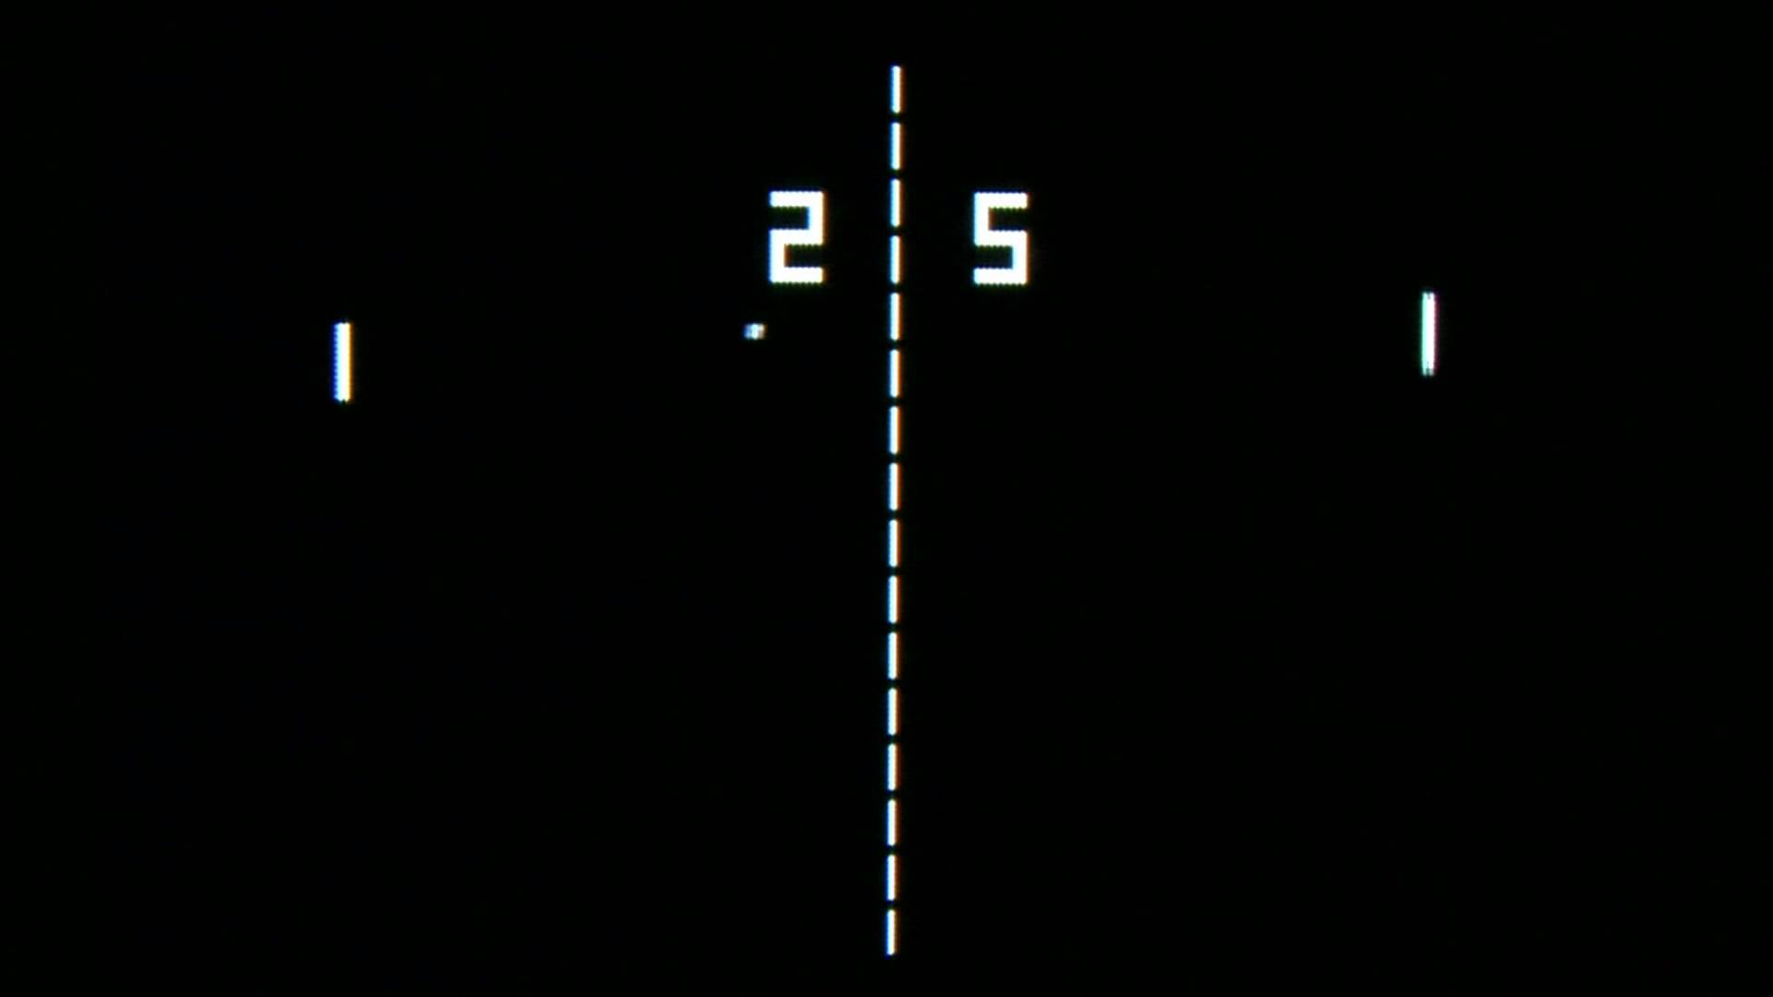

Slide 5
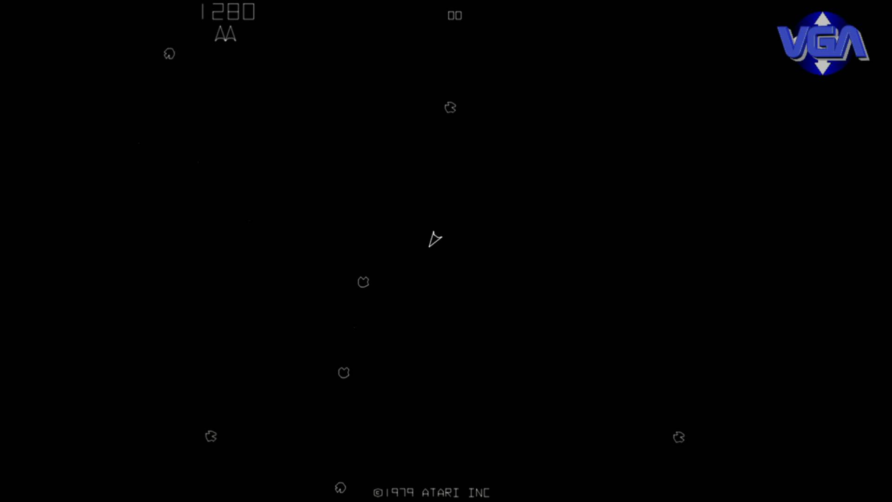

Slide 6
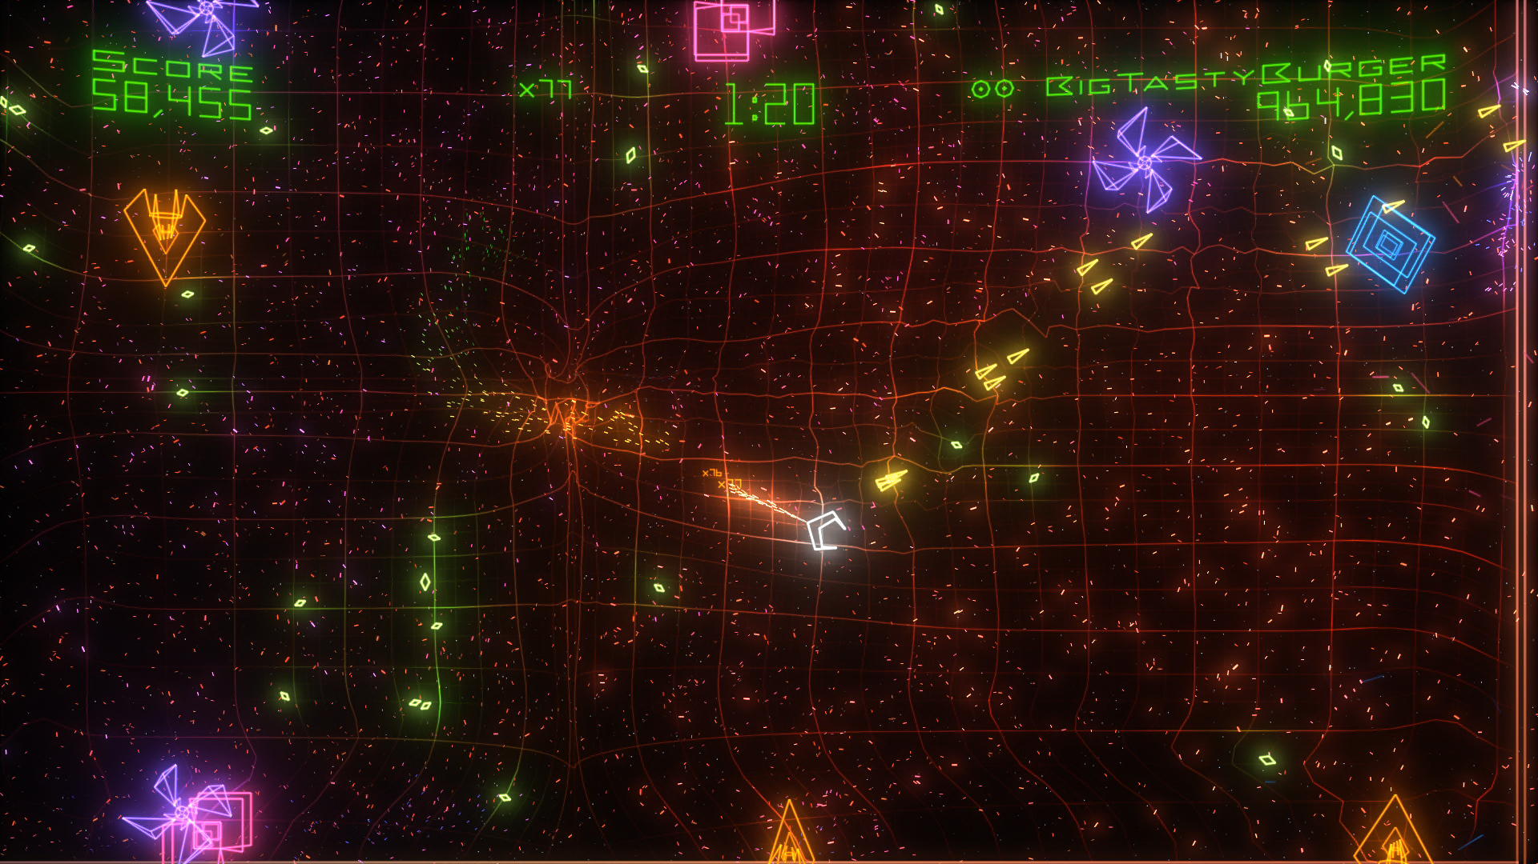

Slide 7
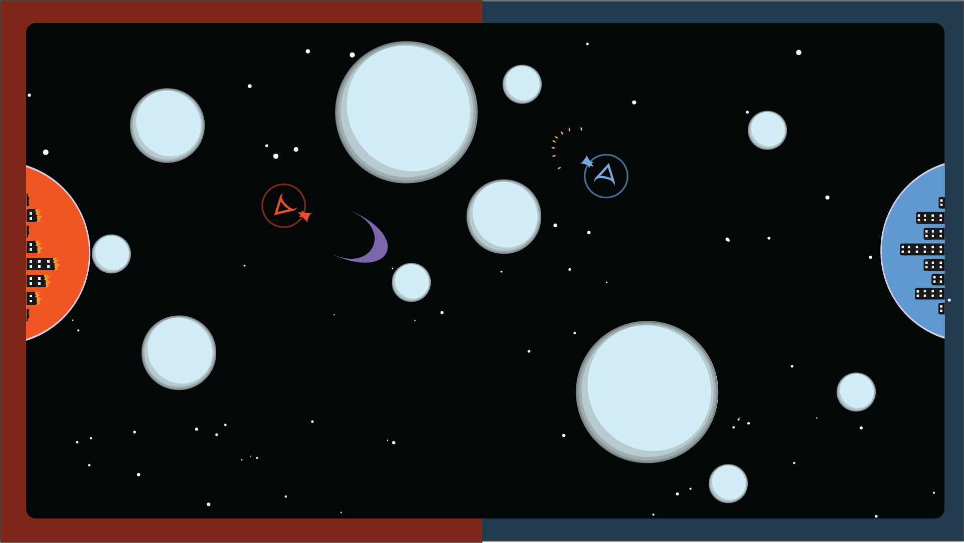

Slide 8
Local Multiplayer
1 vs 1
Short learning curve
Difficult Mastery

Slide 9
Audience
Competitive Gamers
Local Multiplayer

Slide 10
Challenges

Slide 11
Prototyping
Controls: Mouse and Keyboard
Elastic collisions
Wave blast
Damage from speed/mass
Orb splitting

Slide 12
Balance
Variable Soup
Intuitive?

Slide 13
Variables List
Ship Friction
Powerup Amount
Ship Speed
Energy Orb mass
Powerup Random
Thrust
Base HP
Orb break Rand
Shotgun Rebound
Orb Breakpoints
Ship HP
Wave Blast charge amount
Ship mass
Wall Bounce
Orb Blast charge amount
Energy Orb HP
Invuln Timer
Max Speeds
Bullet Mass
Orb Waves
Charge release time window
Wave Blast Force
Orb Wave ramp
Max Powerup amount
Damage Function
Starting Location
Etc, etc, ad nauseum

Slide 14
Future Iterations
1 Player Challenge Mode
3+ Players
A.I.

Slide 15
Thanks for Watching!

